Slide 1
VUSIC
PRESENTED BY:
GEETIKA MEHTA(2201990325)
GOPIKA ASHUTOSH GOYAL(2210990328)
DILJOT KAUR(2210990285)
UNDER SUPERVISION OF
MR.VIKAS PATEL
MS. PARUL
DEPARTMENT OF COMPUTER SCIENCE AND ENGINEERING

Slide 2
INDEX
Introduction
Problem Statement
Motivation
Technologies Used
Code Snapshots
Our Website
Conclusion
Questions
References

Slide 3
INTRODUCTION
Inspired by the popularity of platforms like Spotify, we embarked on a journey to create our own version – Vusic. A platform that not only provides access to millions of songs but also prioritises user experience and innovation.
As music enthusiasts and aspiring developers, our team recognised the importance of creating a platform that not only offers access to a vast library of songs but also enhances the overall listening experience.

Slide 4
PROBLEM STATEMENT
In today's digital age, whether studying, working out, or unwinding, music plays a crucial role in our lives. However, we also understand the limitations and frustrations that users may encounter with existing music streaming platforms.
Existing platforms often fail to fully satisfy users' needs, leading to frustration and dissatisfaction. These platforms lack certain features and functionalities that would enhance the overall listening experience.
Users encounter issues such as limited song availability, repetitive ads, clunky user interfaces, and a lack of personalised recommendations.
These shortcomings highlight the need for a more user-centric and innovative music streaming platform that addresses these pain points and provides a seamless and enjoyable listening experience for all users.
.

Slide 5
MOTIVATION
We love music and wanted to make a platform where people can easily find, share, and enjoy their favourite songs.
Our project is all about giving users a simple and friendly way to listen to music that fits their mood or activity.
Whether you're studying, exercising, or just chilling out, our platform is here to help you find the perfect tunes for any moment.

Slide 6
TECHNOLOGIES USED
React.js (Version 16.13.1): UI component library for dynamic web interfaces.
Redux (Version 4.0.5): Centralised state management for predictable app behaviour.
React Router DOM (Version 5.2.0): Declarative routing for seamless navigation between components.
Material-UI: (Version 4.11.0) for the core components and (Version 4.9.1) for the icons.
Sass [Syntactically Awesome Style Sheets]: (Version 1.49.11) for styling.

Slide 7
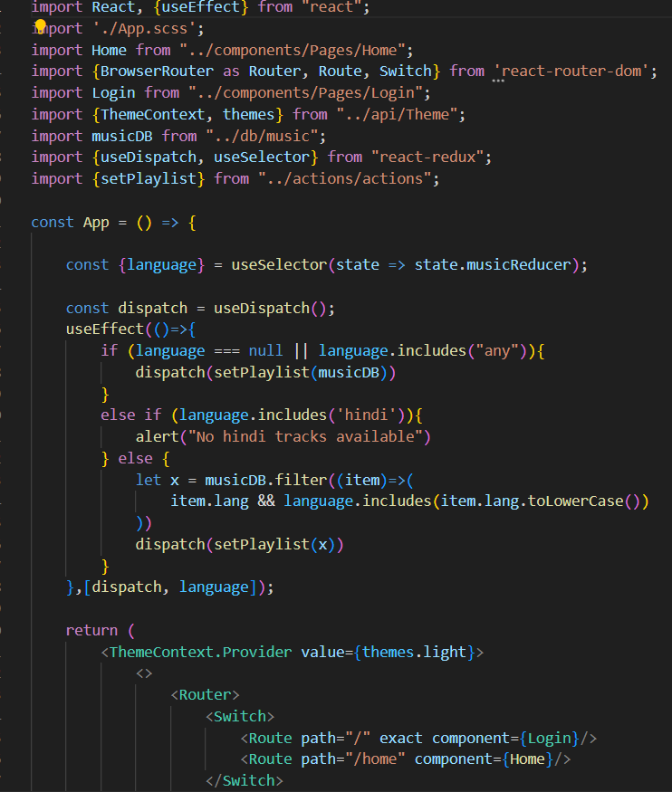
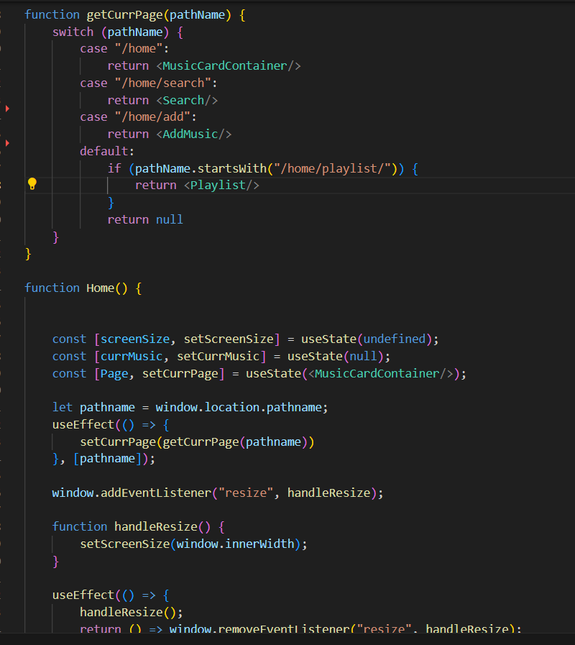
CODE SNAPSHOTS

Slide 8
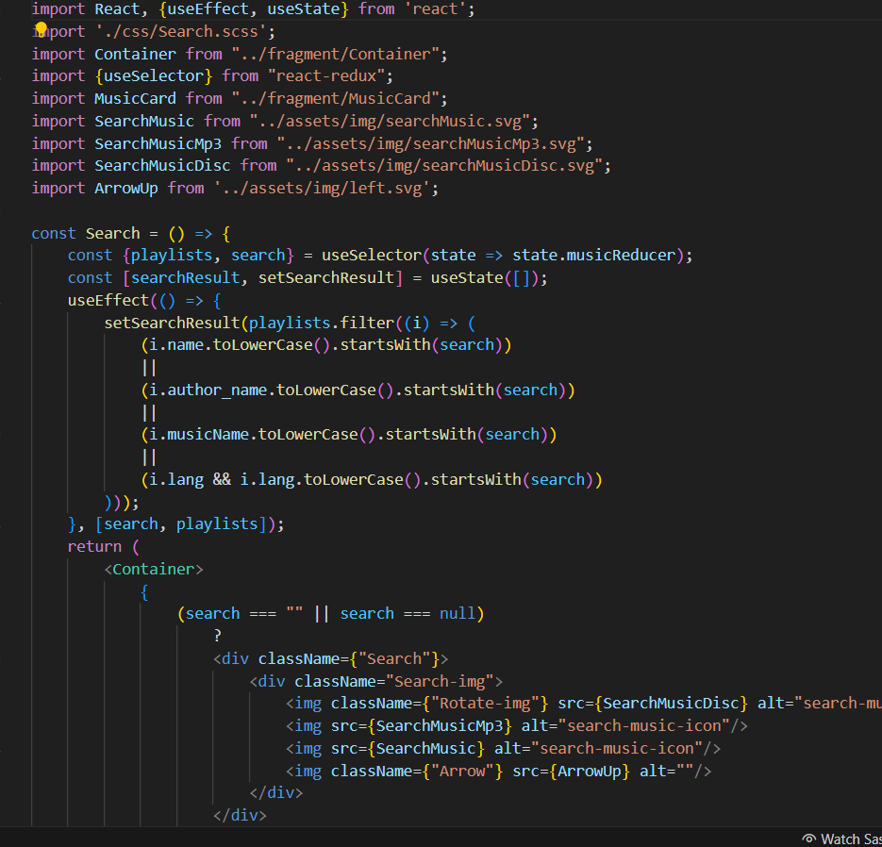
CODE SNAPSHOTS

Slide 9
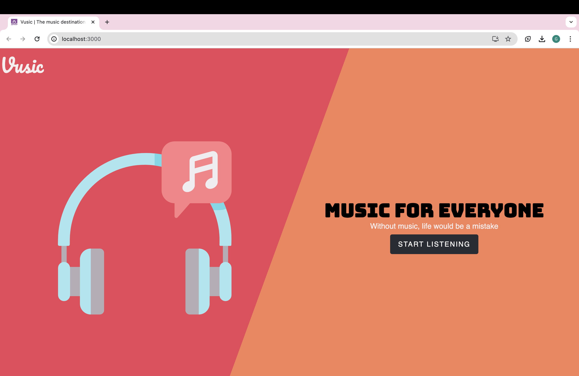
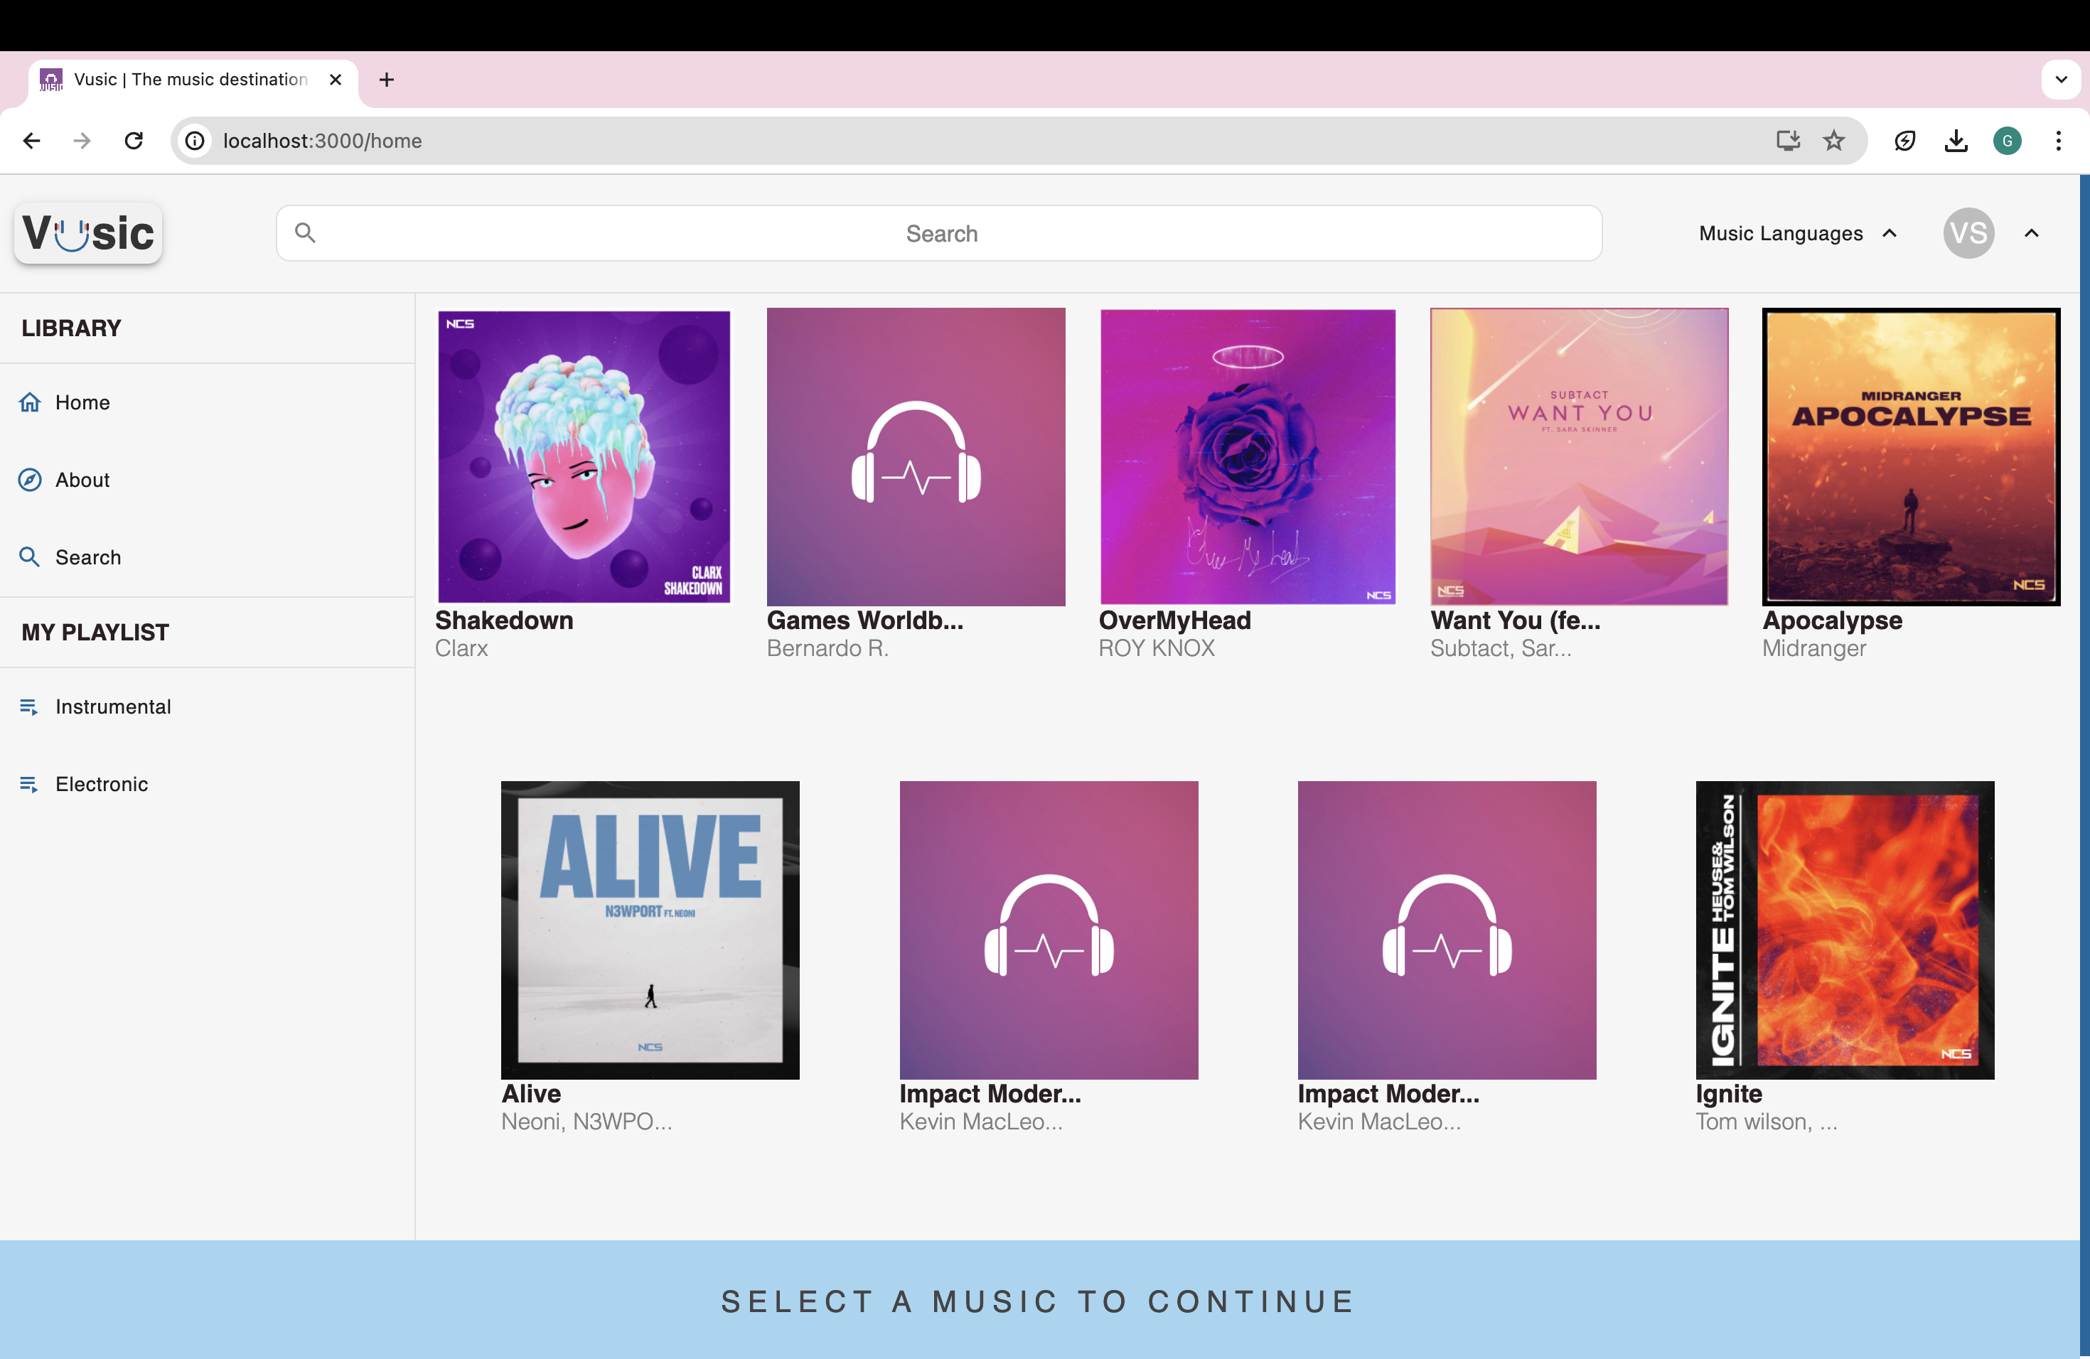
OUR WEBSITE

Slide 10
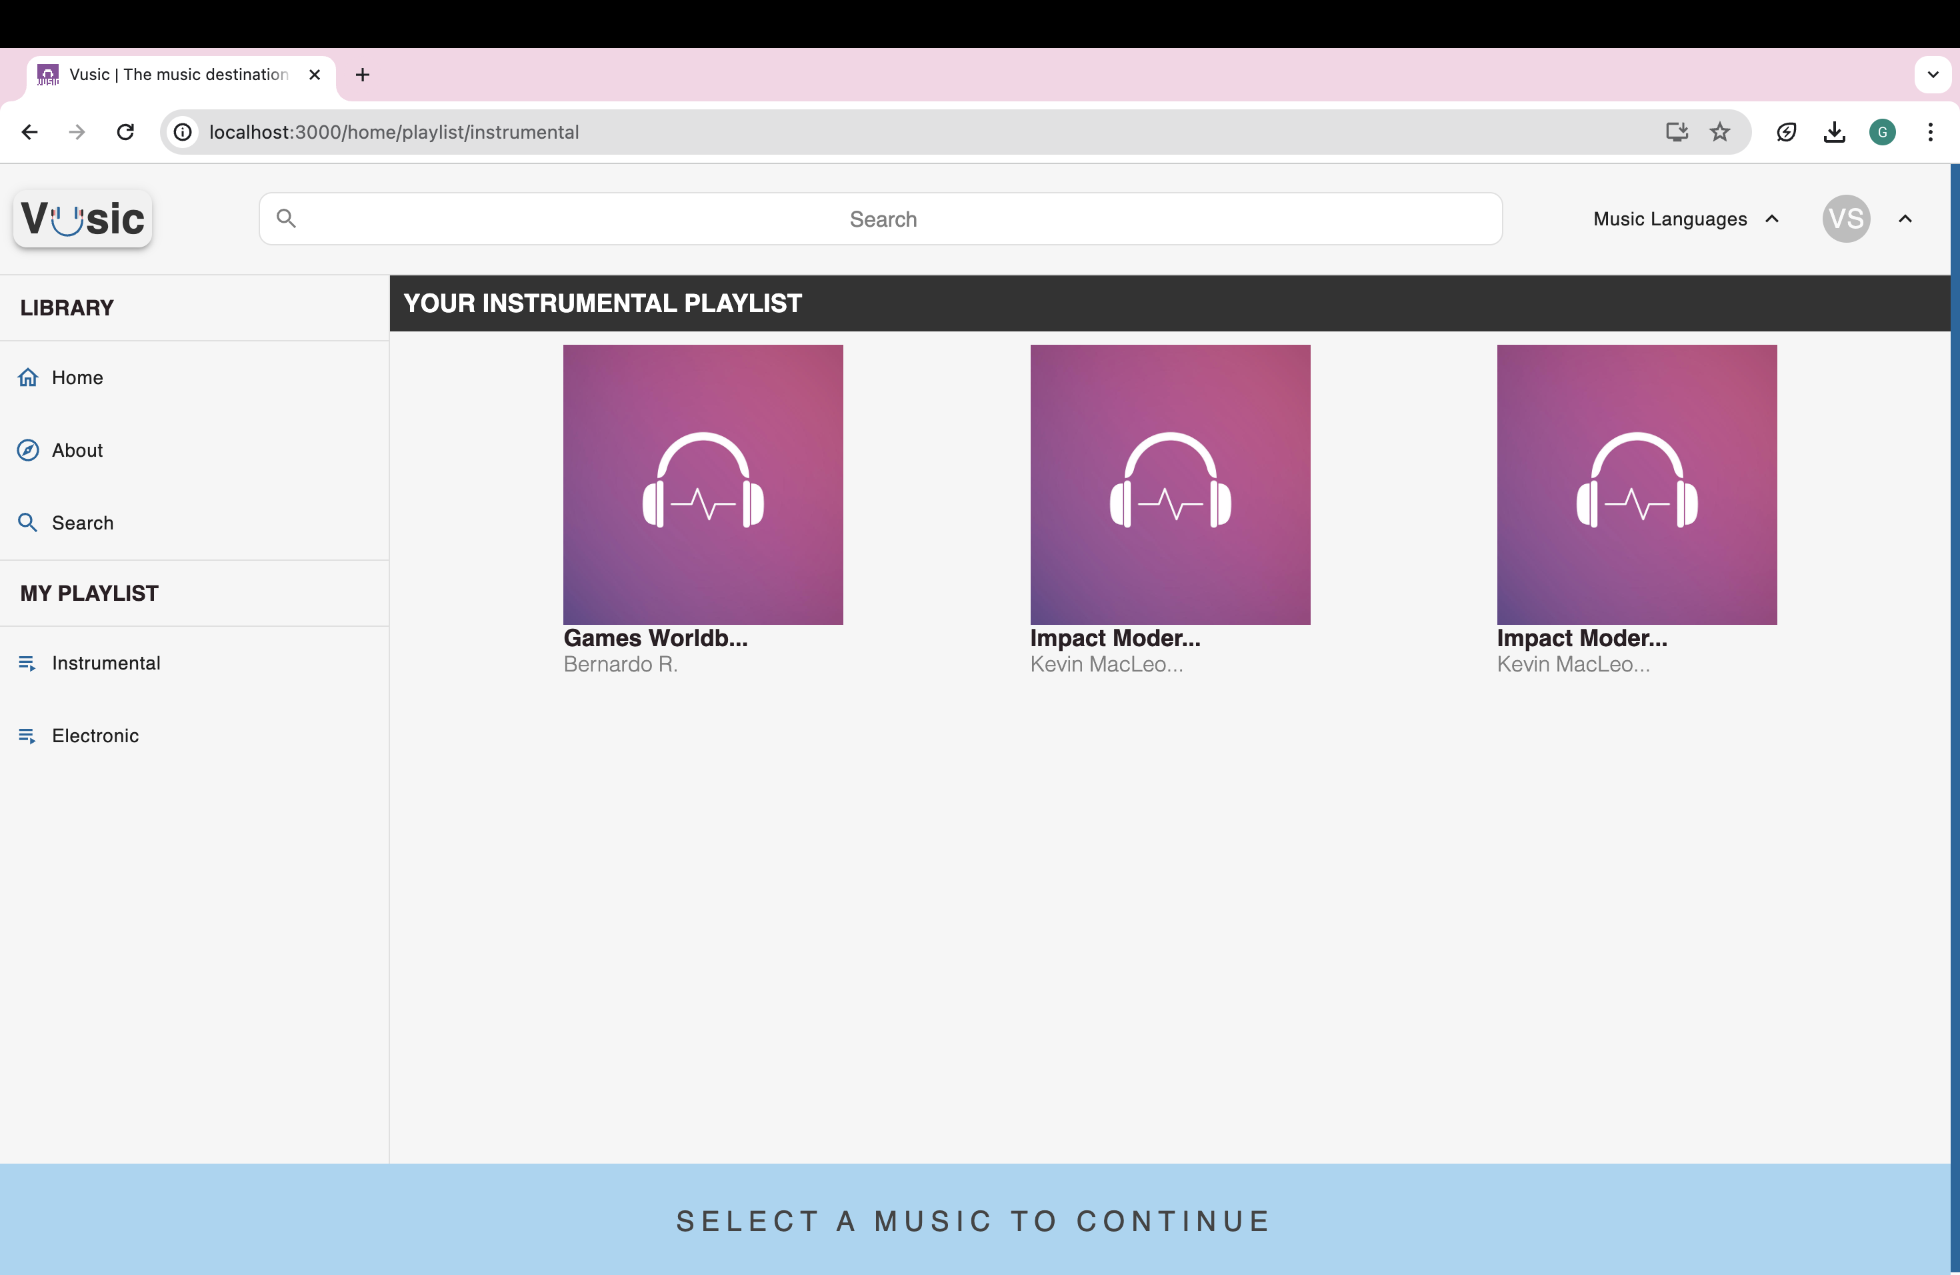
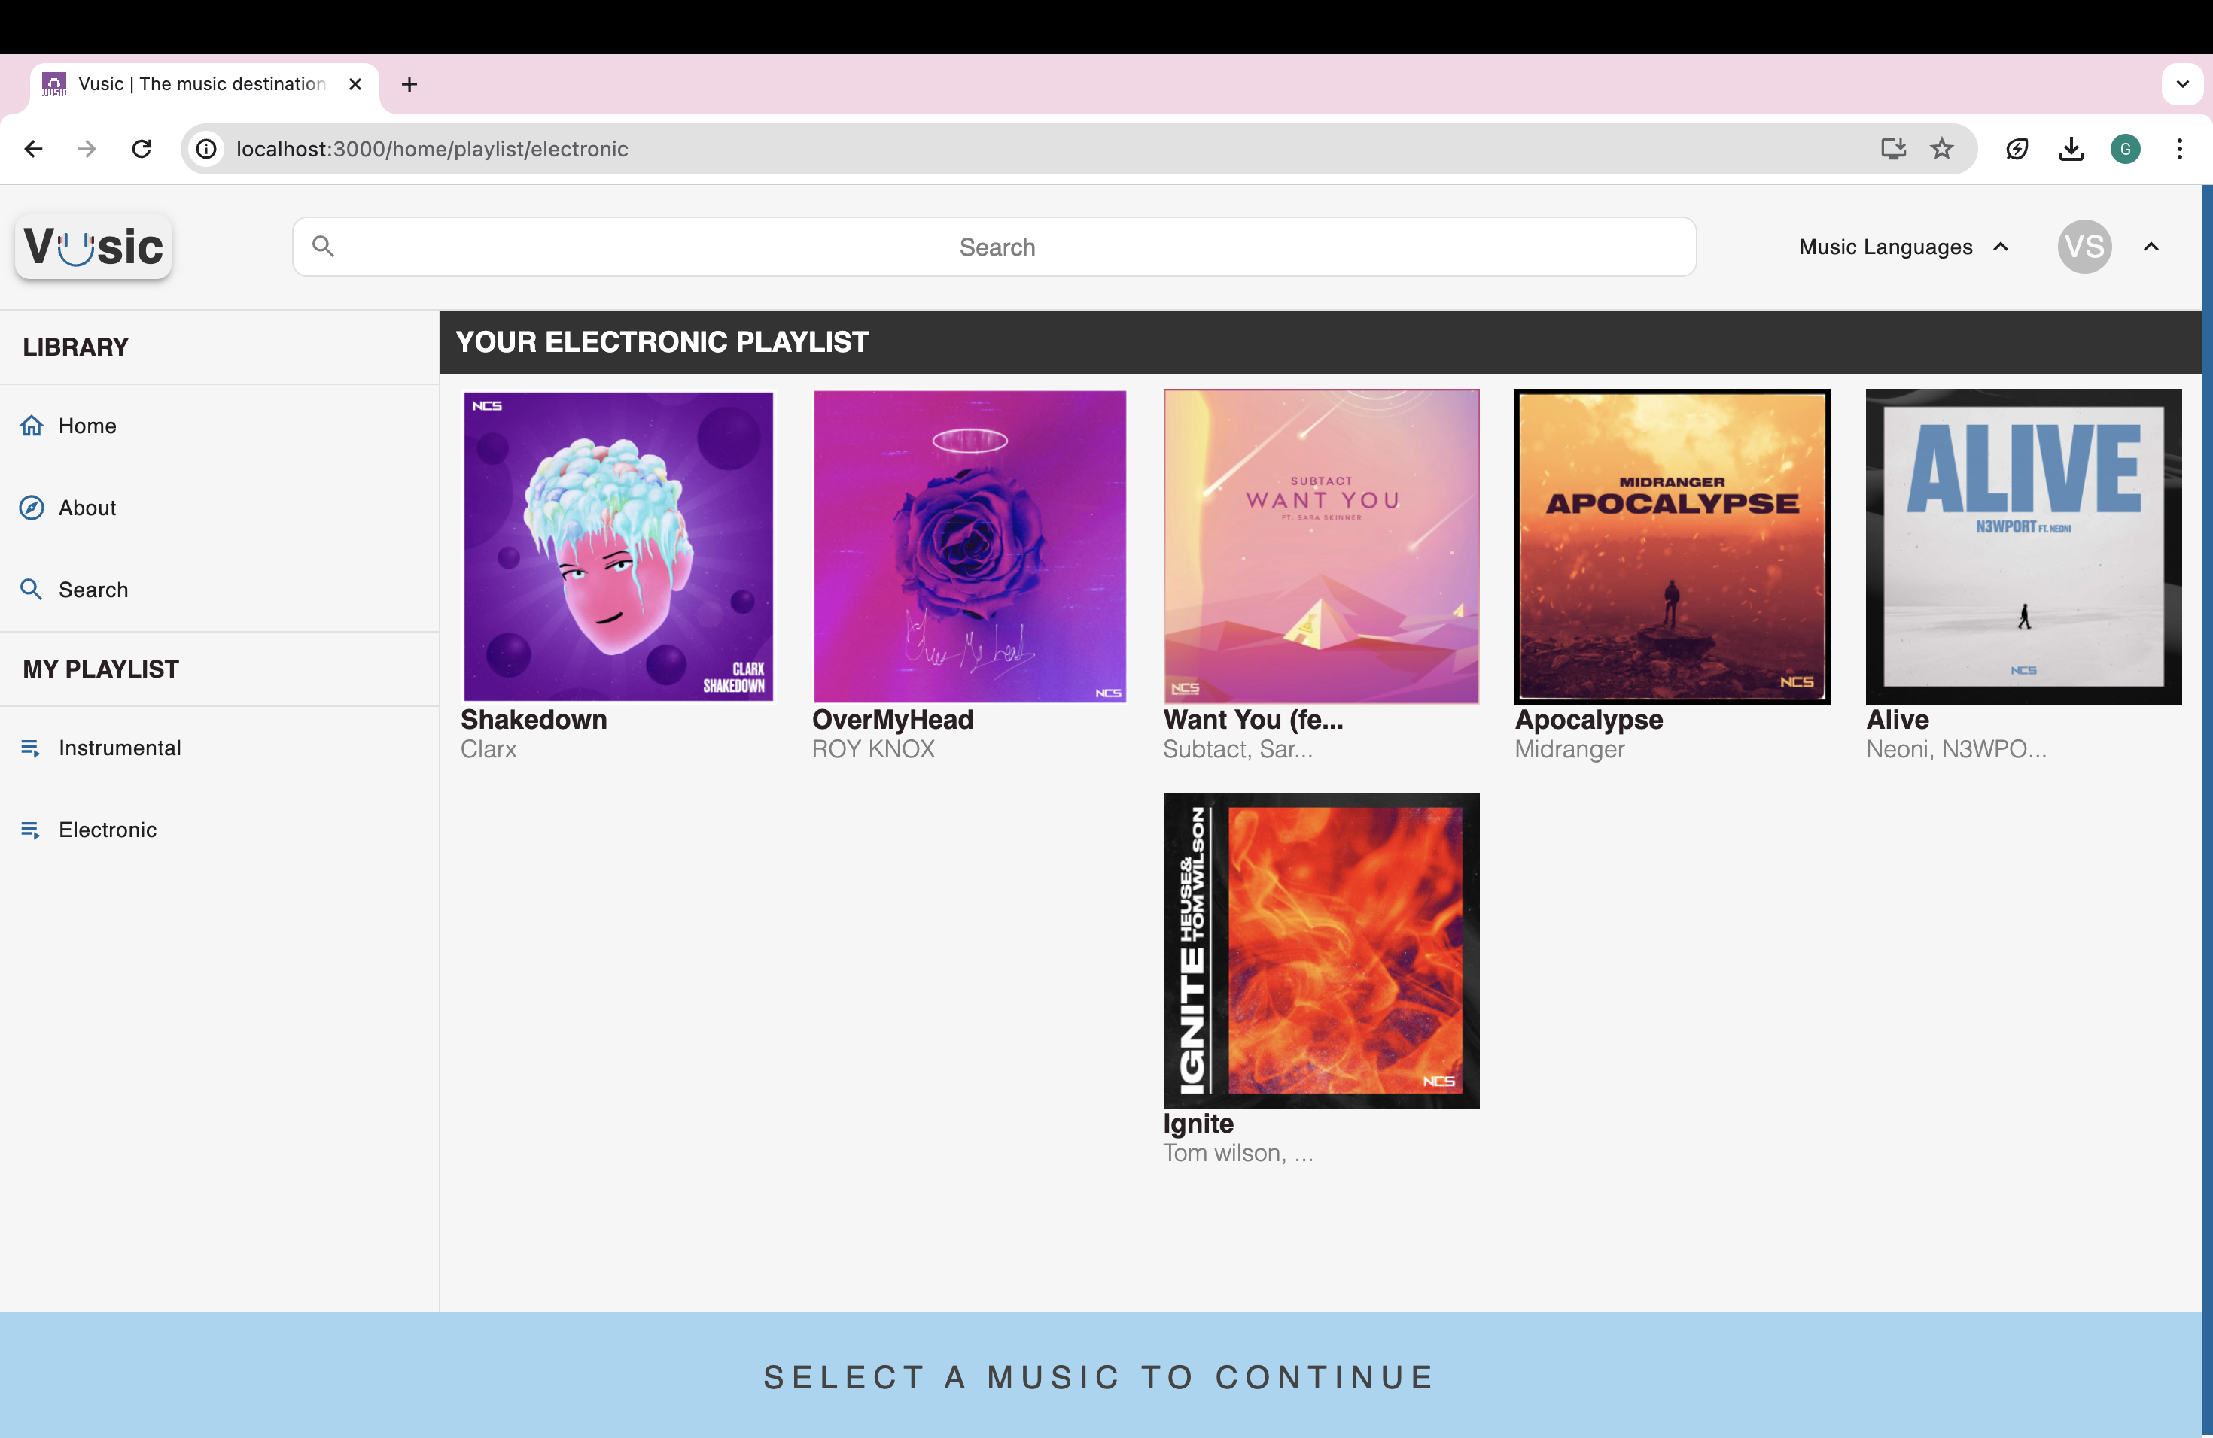
OUR WEBSITE

Slide 11
CONCLUSION
To conclude, our Spotify clone project aims to simplify music discovery and enjoyment for our users.
Through the implementation of a user-friendly interface and the integration of innovative features, such as personalised recommendations and collaborative playlist creation, we strive to enhance every aspect of the music streaming journey.
By prioritising simplicity, convenience, and engagement, we aim to create a platform that resonates with our peers and enriches their musical experiences.

Slide 12

QUESTIONS

Slide 13
REFERENCES
https://www.w3schools.com/REACT/DEFAULT.ASP
https://www.javatpoint.com/react-redux
https://www.geeksforgeeks.org/react-material-ui/
https://open.spotify.com/
https://music.amazon.in/

Slide 14

THANK YOU!

